Slide 1




High Level Design
Amazon Sales Data Analysis

Slide 2
Document Overview
Document Version : 1.2
Date : 30-09-2023

Slide 3
Table of Contents
Abstract
Scope
General Description
Design Details
KPI
Deployment

Slide 4
Abstract
Organizations under the E-commerce industry seek to attain core competence by creating and sustaining a unique process to collect personal information about customers and their purchasing trends. The report critically evaluates how a service-based organization -Amazon uses Management information systems as a vibrant tool in attaining competitive advantage through efficient management and acquisition of information. As in today’s market without proper sales management, it’s very hard to predict how the business is running and how it will be in future. Many companies with proper sales management have shown better growth as they already know which item they have to focus on, which product needs some improvement etc. Sales Management helps in maintaining its customer base for a longer time by providing them attractive offers, as they already have the information’s like who are their top customers, whom they have to focus on etc. Sales Management also helps in minimizing the losses. Also, Competition is increasing day by day as many new companies are coming with better management systems and giving tough competition due to that it is now very important to have a proper Sales Management to run any business and to compete with these companies.

Slide 5
Scope
The HLD documentation presents the structure of the system, such as the database architecture, application architecture (layers), application flow (Navigation), and technology architecture. The HLD uses non-technical to mildly-technical terms which should be understandable to the administrators of the system.

Slide 6
General Description
Product Perspective & Problem Statement
This Project aims to Analyze Amazon Sales from 2017 to 2019 to know more in-depth information about the items that are in high demand, items that are generating high profits which items should not be sold and how much stock we have to maintain for further Sales etc.

Slide 7
General Description
Tools Used
Business Intelligence tools and libraries works such as NumPy, Pandas, Seaborn, Matplotlib, MS-Excel, Salesforce Tableau , Jupyter Notebook and Python Programming Language are used to build the whole framework.

Slide 8








Slide 9
Design Details

Slide 10
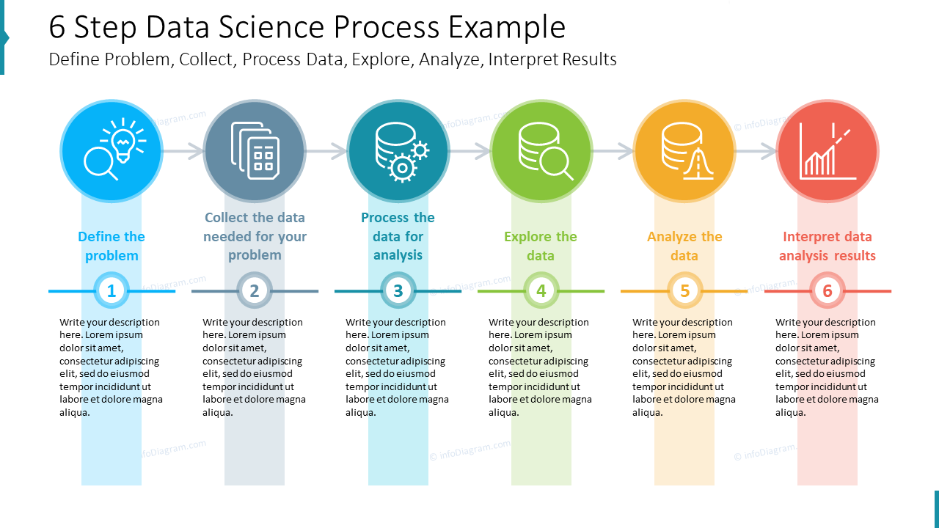

Slide 11
Tableau Architecture

Slide 12

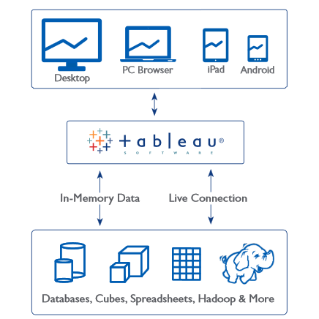

Slide 13
Optimization
Your data strategy drives performance
Minimize the number of fields
Minimize the number of records
Optimize extracts to speed up future queries by materializing calculations, removing columns and the use of accelerated views

Slide 14
Optimization
Reduce the marks (data points) in your view
Practice guided analytics. There’s no need to fit everything you plan to show in a single view. Compile related views and connect them with action filters to travel from overview to highly-granular views at the speed of thought.
Remove unneeded dimensions from the detail shelf.
Explore. Try displaying your data in different types of views.

Slide 15
Optimization
Limit your filters by number and type
Reduce the number of filters in use. Excessive filters on a view will create a more complex query, which takes longer to return results. Double-check your filters and remove any that aren’t necessary.
Use an include filter. Exclude filters load the entire domain of a dimension while including filters do not. An include filter runs much faster than an exclude filter, especially for dimensions with many members.
Use a continuous date filter. Continuous date filters (relative and range-of-date filters) can take advantage of the indexing properties in your database and are faster than discrete data filters.
Use Boolean or numeric filters. Computers process integers and Booleans (t/f) much faster than strings.
Use parameters and action filters. These reduce the query load (and work across data sources).

Slide 16
Optimization
Optimize and materialize your calculations
1. Perform calculations in the database
2. Reduce the number of nested calculations.
3. Reduce the granularity of LOD or table calculations in the view. The more granular the calculation, the longer it takes.
LODs - Look at the number of unique dimension members in the calculation.
Table Calculations - the more marks in the view, the longer it will take to calculate.
4. Where possible, use MIN or MAX instead of AVG. AVG requires more processing than MIN or MAX. Often rows will be duplicated and display the same result with MIN, MAX, or AVG.

Slide 17
Optimization
Optimize and materialize your calculations
5. Make groups with calculations. Like include filters, calculated groups load only named members of the domain, whereas Tableau’s group function loads the entire domain.
6. Use Booleans or numeric calculations instead of string calculations. Computers can process integers and Booleans (t/f) much faster than strings. Boolean>Int>Float>Date>DateTime>String.

Slide 18
KPI
1
Key Performance Indicator

Slide 19
Dashboards will be implemented to display and indicate certain KPIs and relevant indicators for the disease.
As and when the system starts to capture the historical/periodic data for a user, the dashboards will be included to display charts over time with progress on various indicators or factors

Slide 20
Deployment

Slide 21
Prioritizing data and analytics couldn’t come at a better time. Your company, no matter what size, is already collecting data and most likely Analysing just a portion of it to solve business problems, gain competitive advantages, and drive enterprise transformation. With the explosive growth of enterprise data, database technologies, and the high demand for analytical skills, today’s most effective IT organizations have shifted their focus to enabling self-service by deploying and operating Tableau at scale, as well as organizing, orchestrating, and unifying disparate sources of data for business users and experts alike to author and consume content.
Tableau prioritizes choice in flexibility to fit, rather than dictate, your enterprise architecture. Tableau Desktop and Tableau Service leverage your existing technology investments and integrate them into your IT infrastructure to provide a self-service, modern analytics platform for your users. With on-premises, cloud, and hosted options, there is a version of Tableau to match your requirements.

Slide 22
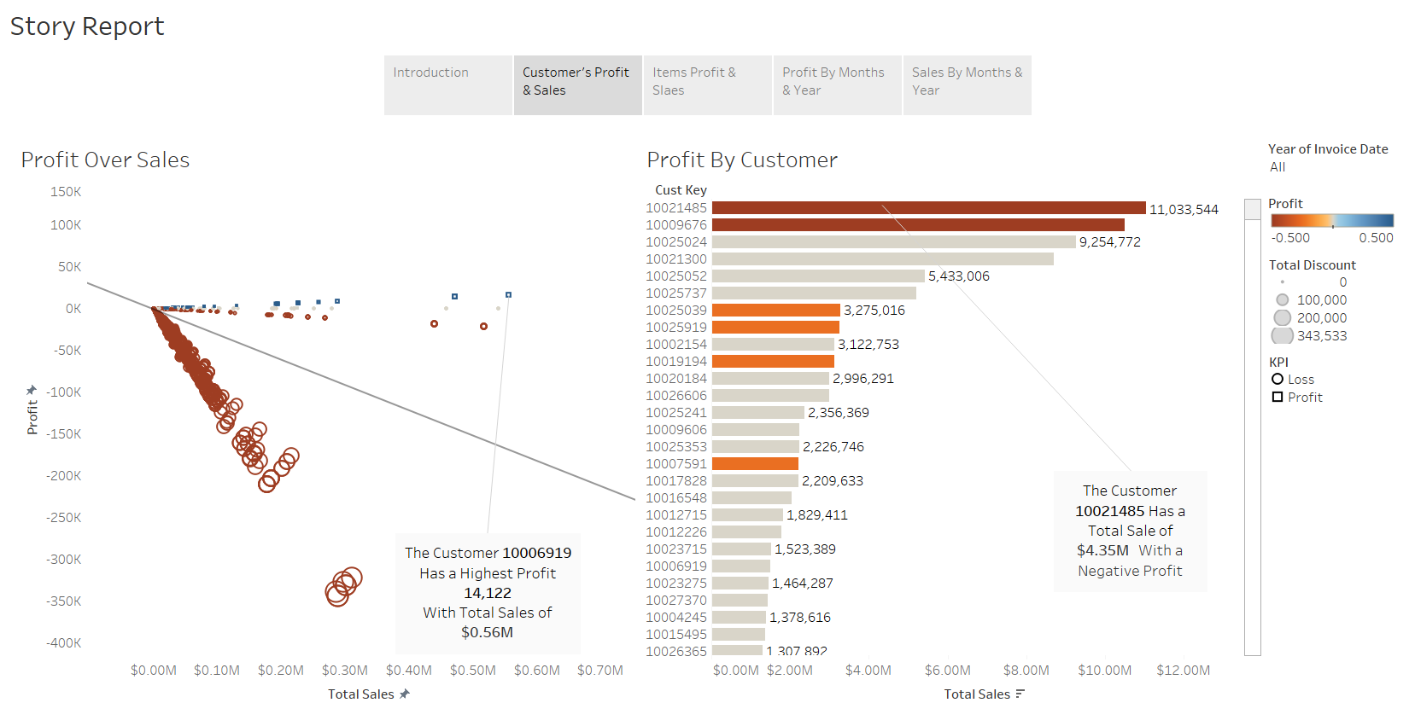

Slide 23
